Slide 1
ADO.NET - Lesson 06
Adding Parameters to Commands
Training time: 15 minutes
Author: CuongNV3

Slide 2
Objectives
Understand what a parameter is.
Be informed about the benefits of using parameters.
Learn how to create a parameter.
Learn how to assign parameters to commands.

Slide 3
Introduction
When working with data, you'll often want to filter results based on some criteria. Typically, this is done by accepting input from a user and using that input to form a SQL query
For example, a sales person may need to see all orders between specific dates. Another query might be to filter customers by city.
  Dad example of filtering a query
  Should using parameters

Slide 4
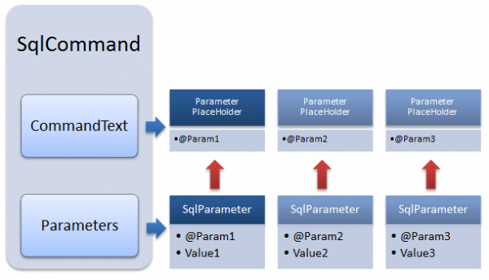
Introduction (2)
Using parameterized queries is a three step process:
  Construct the SqlCommand command string with parameters.
  Declare a SqlParameter object, assigning values as appropriate.
  Assign the SqlParameter object to the SqlCommand object's Parameters property.

Slide 5
Preparing a SqlCommand Object for Parameters
The first step in using parameters in SQL queries is to build a command string containing parameter placeholders. These placeholders are filled in with actual parameter values when the SqlCommand executes.
Proper syntax of a parameter is to use an '@' symbol prefix on the parameter name as shown below:

Slide 6

Declaring a SqlParameter Object
Each parameter in a SQL statement must be defined.
This is the purpose of the SqlParameter type.
Your code must define a SqlParameter instance for each parameter in a SqlCommand object's SQL command.
The following code defines a parameter for the @City parameter from the previous section:

Slide 7

Associate a SqlParameter Object with a SqlCommand Object
For each parameter defined in the SQL command string argument to a SqlCommand object, you must define a SqlParameter.
You must also let the SqlCommand object know about the SqlParameter by assigning the SqlParameter instance to the Parameters property of the SqlCommand object.
You must add a unique SqlParameter for each parameter defined in the SqlCommand object's SQL command string.
The following code shows how to do this:
Demo

Slide 8
Summary
You should use parameters to filter queries in a secure manner.
The process of using parameter contains three steps:
  Define the parameter in the SqlCommand command string
  Declare the SqlParameter object with applicable properties
  Assign the SqlParameter object to the SqlCommand object.
When the SqlCommand executes, parameters will be replaced with values specified by the SqlParameter object.

Slide 9
Q&A
Thanks!

